Slide 1
CO :- 103
COMPUTER ORGANIZATION
D L PIMT BCA COLLAGE
HIMATNAGAR
COMMUNICATION DEVICE
1.NIC

Slide 2
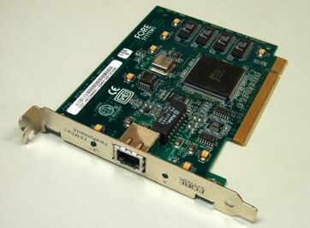
NIC Figures

Slide 3
NIC :-
NIC NETWORK INTERFACE CARD)
Network interface card is also known as a network interface controller NETWORK adapter or LAN adapter which is a computer hardware component that connect a computer to a computer network it is commonly use on expansion cards that plug into a computer bus.
A NIC(network interface card ) is required to connect to the table .
[continue….]

Slide 4
NIC is the equipment directly related to computer and designed for network computers communicate with each other NIC also provide access to physical network .NIC is an example of devices that work on the first two layers or physical or data link layer of the OSI model .

Slide 5
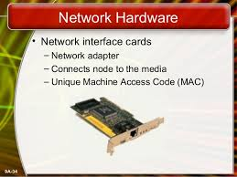
the NIC has a RAM chip that has a unique media access control(MAC) address burned into it ; the MAC address identifiers the vendor and the serial number of the NIC which is unique to the card every NIC card has a unique MAC address which identifiers it on the LAN .
[continue….]

Slide 6
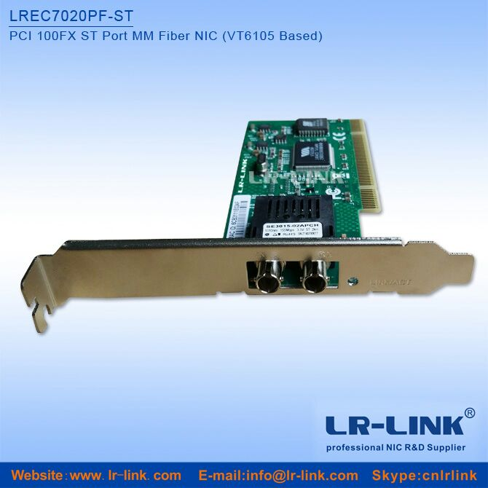

Slide 7
Every NIC must be configured with the following information :
Protocols:- the same protocol must be implemented between any to computer that communicate on the same network .
IP ADDRESS:- this address is configurable and must be unique to each device the ip ip address can be enter manually or automatically via DHCP.#

Slide 8
MAC ADDRESS :- each device has a unique the ip address mac address the mac address is assign by
The manufactured and can not be changed .
Once the computer is connected , the connectivity shoud be tasted by using the ping command use the ipconfigured command to find out what the ip address
Is .ping your own ip address to make sure that your NIC is working
Properly.

Slide 9
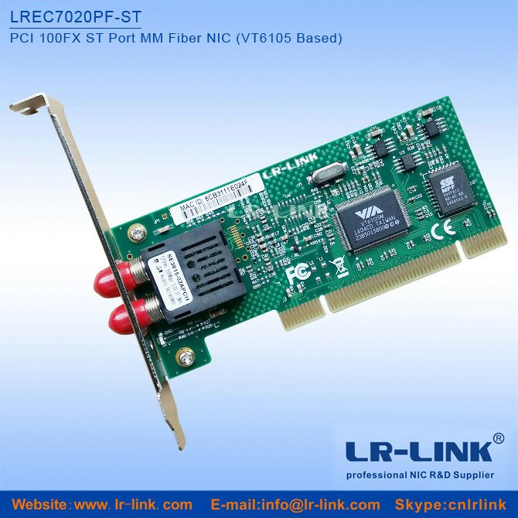
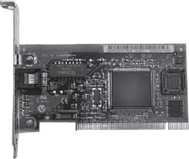

Slide 10
Thank You

